Slide 1
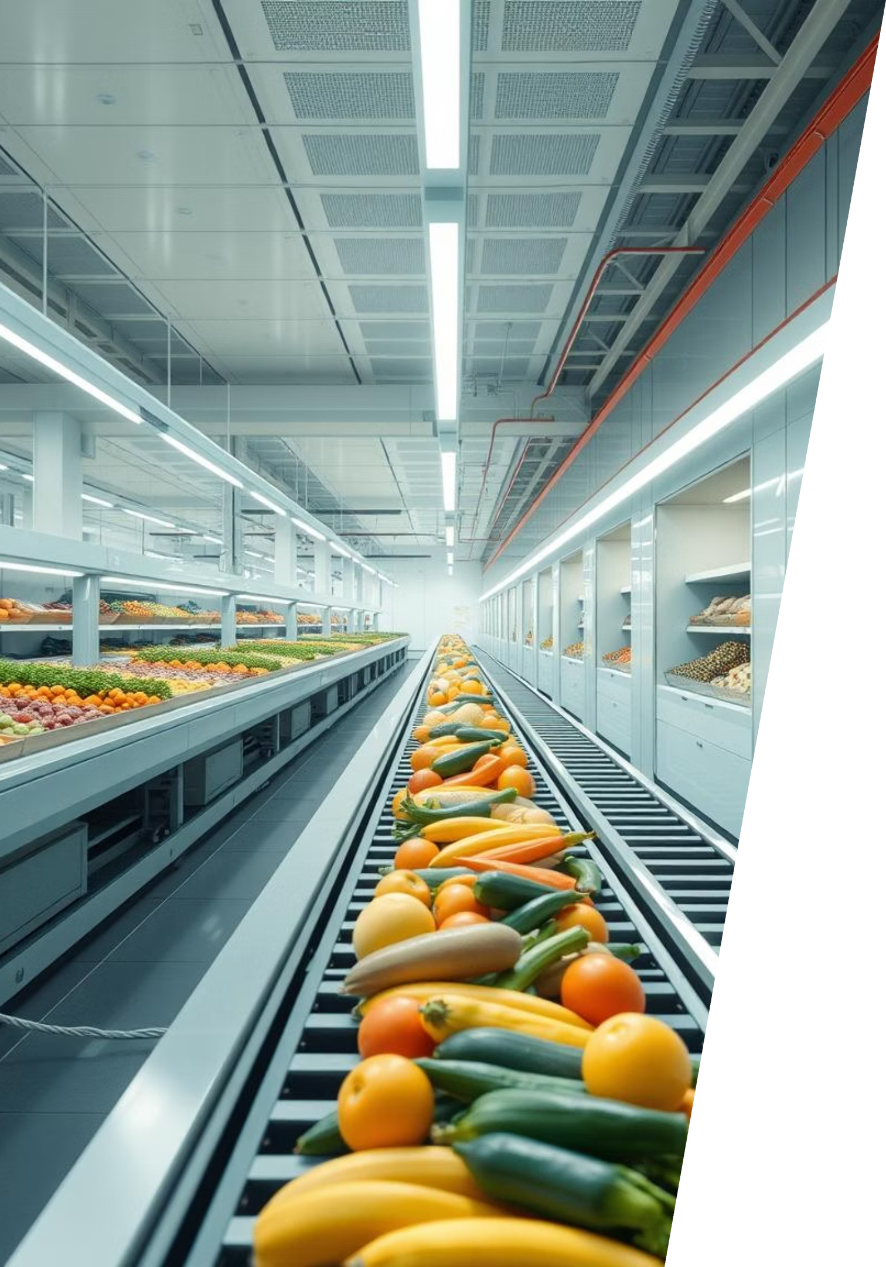
Smart Sorting: Transfer Learning for Identifying Rotten Fruits and Vegetables
This presentation explores the development and application of an AI-powered web application designed to revolutionize fruit and vegetable sorting through transfer learning. Our solution aims to enhance efficiency, reduce waste, and streamline quality control in the agricultural and food industries.

Slide 2

Introduction to AI-Powered Produce Sorting
AI-Powered Web Application
An innovative web application that leverages artificial intelligence to efficiently sort fruits and vegetables. This system automates a previously labor-intensive task, ensuring consistency and speed.
Healthy or Rotten Classification
The core functionality involves classifying produce as either healthy or rotten using advanced machine learning algorithms, minimizing human error and maximizing accuracy in quality assessment.
Reducing Manual Labor and Food Wastage
Our primary goal is to significantly reduce the need for manual sorting, thereby cutting down labor costs and, more importantly, decreasing food waste by accurately identifying and separating unmarketable produce.
Revolutionizing Quality Control
This project is set to transform sorting and quality control within the agricultural and food sectors, offering a scalable and efficient solution for businesses of all sizes.

Slide 3
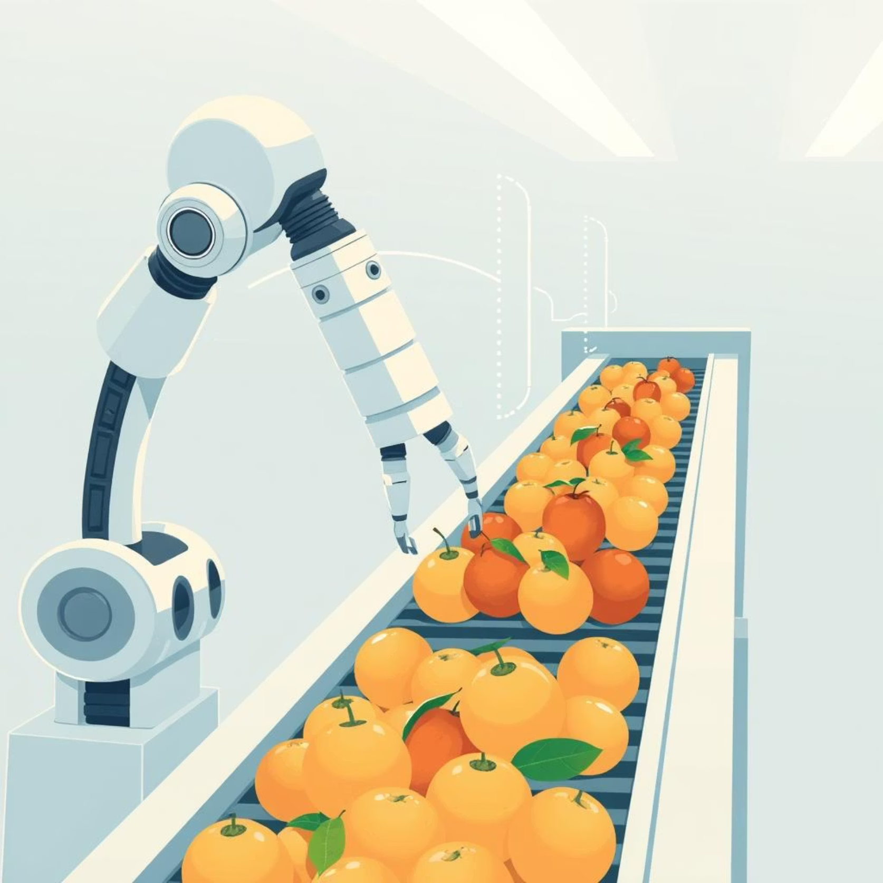
Key Objectives of the Smart Sorting Project
Automate Sorting
To develop an automated system for sorting fruits and vegetables, reducing reliance on manual inspection.
Improve Accuracy
To significantly enhance the precision of quality control by leveraging machine learning models.
Reduce Time and Labor
To decrease the operational time and labor costs associated with traditional sorting methods.
User-Friendly Web Interface
To provide an intuitive, web-based platform for easy image uploads and immediate classification results.

Slide 4
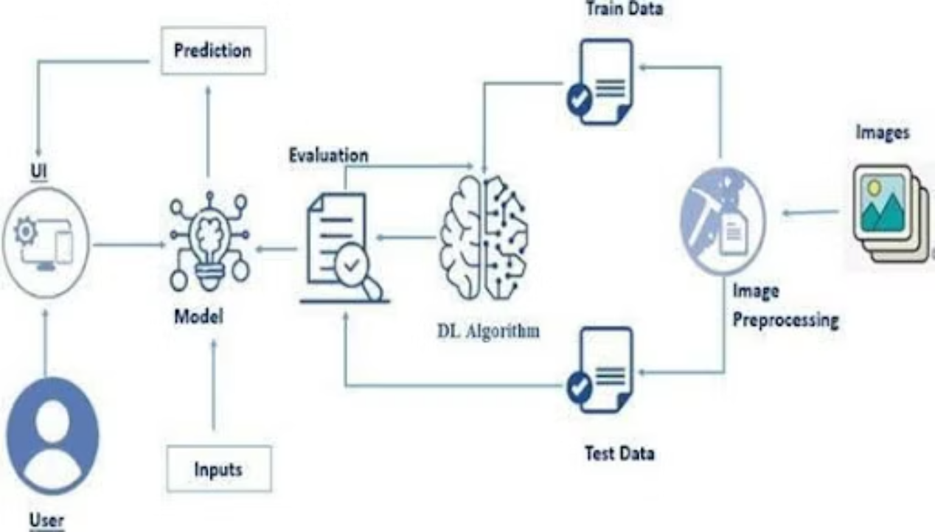
Methodology: Building the Smart Sorting System
Data Collection
Gathering a comprehensive dataset of images for both healthy and rotten produce, ensuring diverse examples for robust training.
Model Development
Implementing a Convolutional Neural Network (CNN) for image classification, utilizing transfer learning to accelerate development and enhance performance.
Web Development
Building the backend with the Flask framework to handle image uploads, process requests, and deliver classification results.
Deployment & Interface
Creating a user-friendly interface that allows for seamless image upload and clear display of sorting outcomes.
Testing & Evaluation
Rigorously testing the system for accuracy, speed, and reliability across various types of produce.

Slide 5
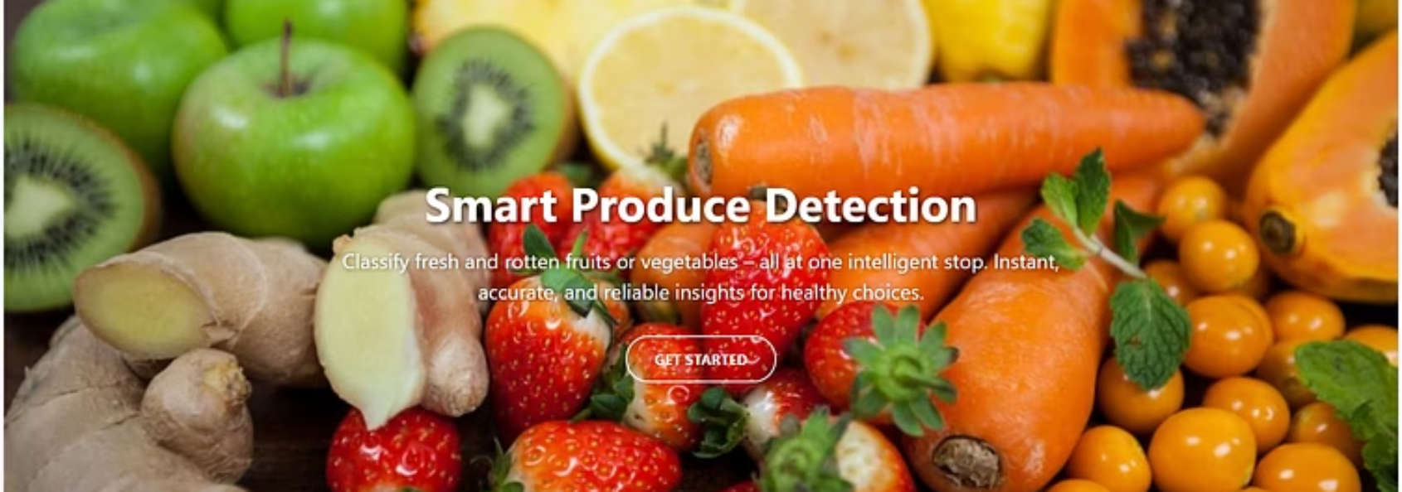
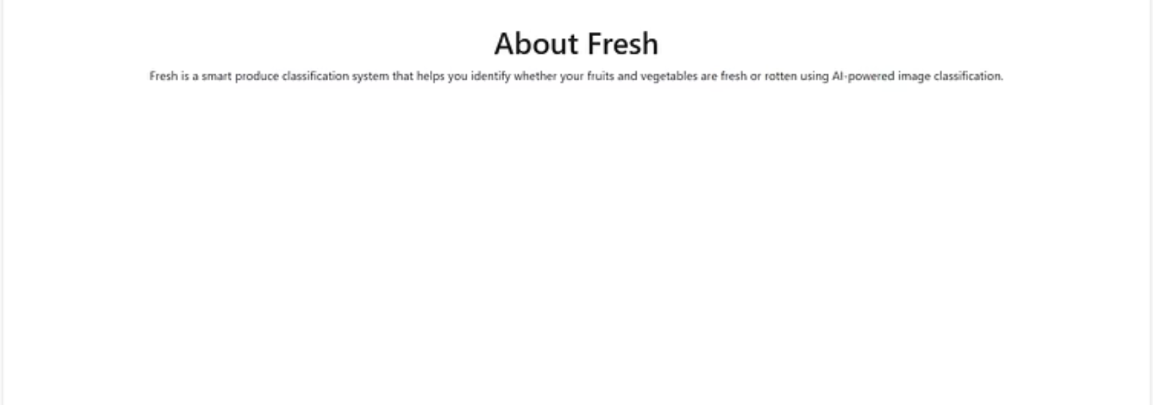
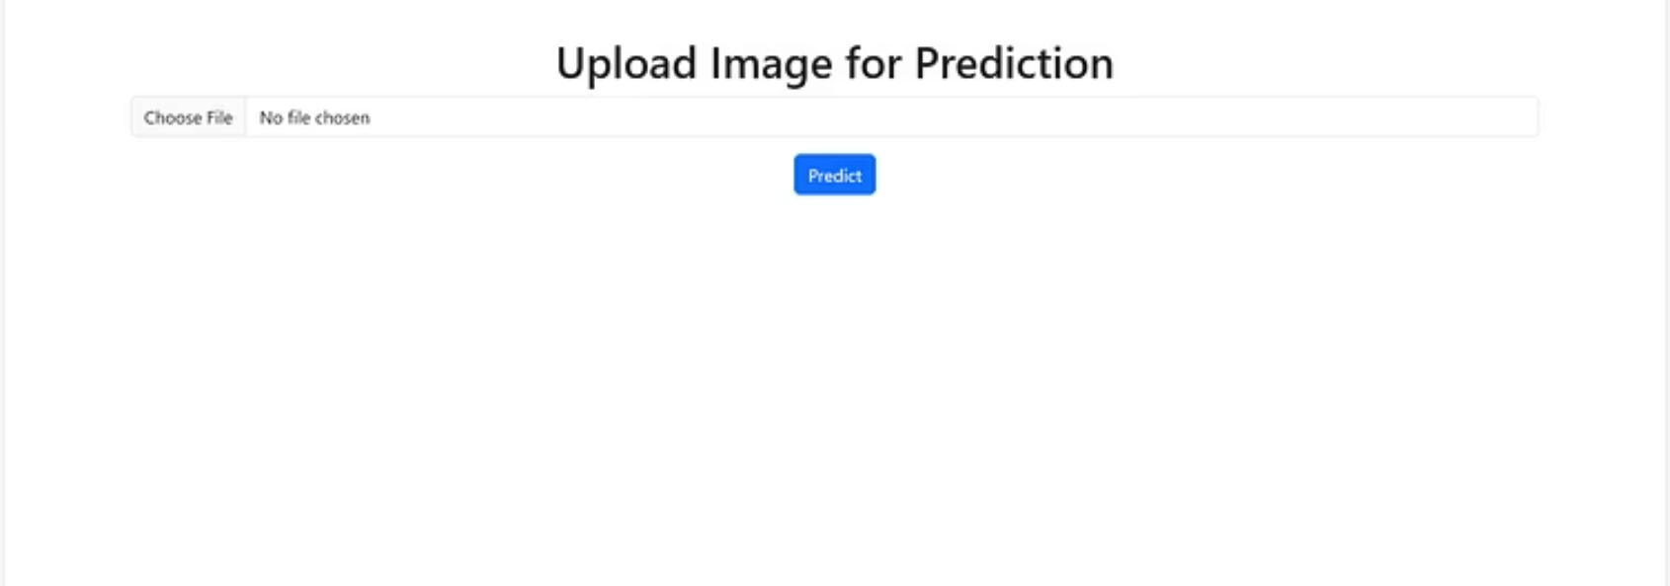
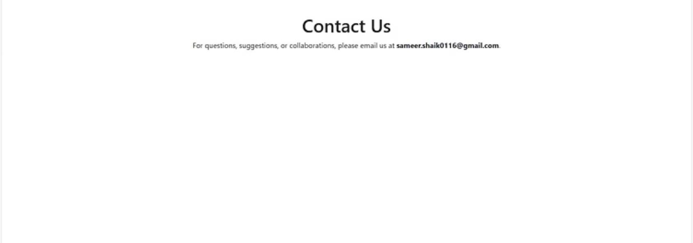
Visualizing Classification Results
The images above demonstrate the efficacy of our smart sorting system, showcasing various fruits and vegetables classified as healthy or rotten. Our model achieves high accuracy rates in distinguishing between produce conditions, which is crucial for maintaining quality standards and reducing waste in supply chains. The visual output provides clear and immediate feedback, aiding users in making informed decisions.

Slide 6
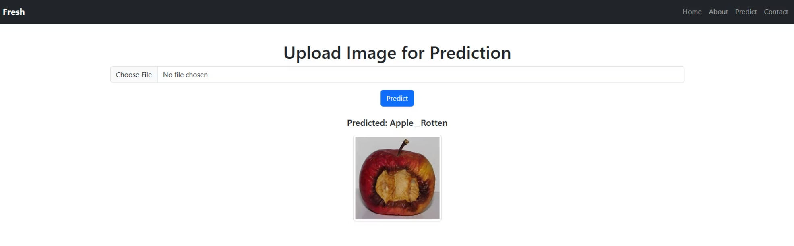


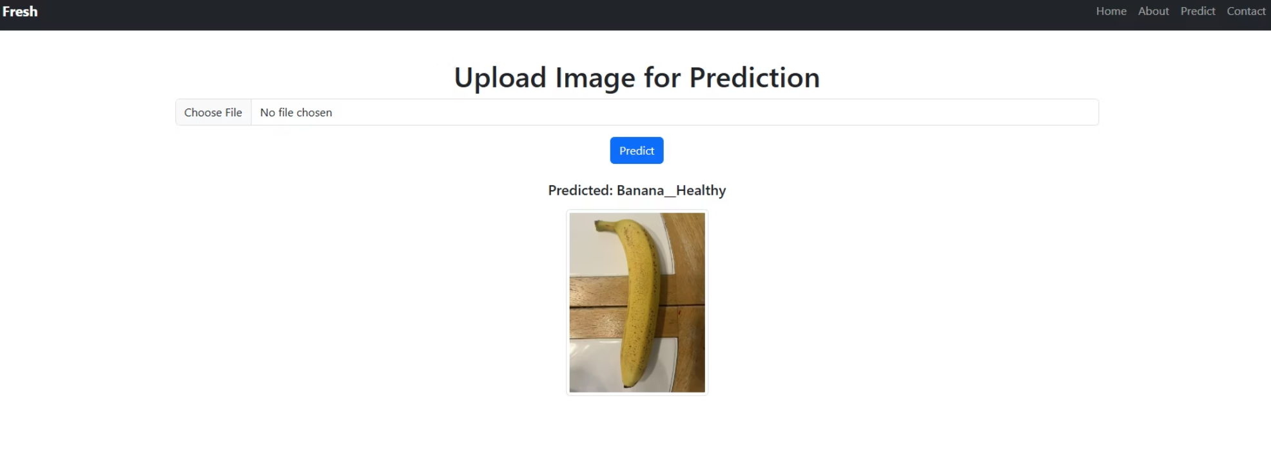


Prediction: Real-Time Quality Assessment
Capture & Upload
Users capture produce images via mobile or integrated cameras, initiating instant analysis.
AI Analysis
Our AI model instantly analyzes the image, leveraging advanced transfer learning techniques for rapid processing.
Instant Prediction
Receive immediate, highly accurate predictions classifying produce as healthy or rotten.
Actionable Insights
Rapid assessment facilitates quick sorting decisions, minimizing waste and optimizing quality control processes.

Slide 7
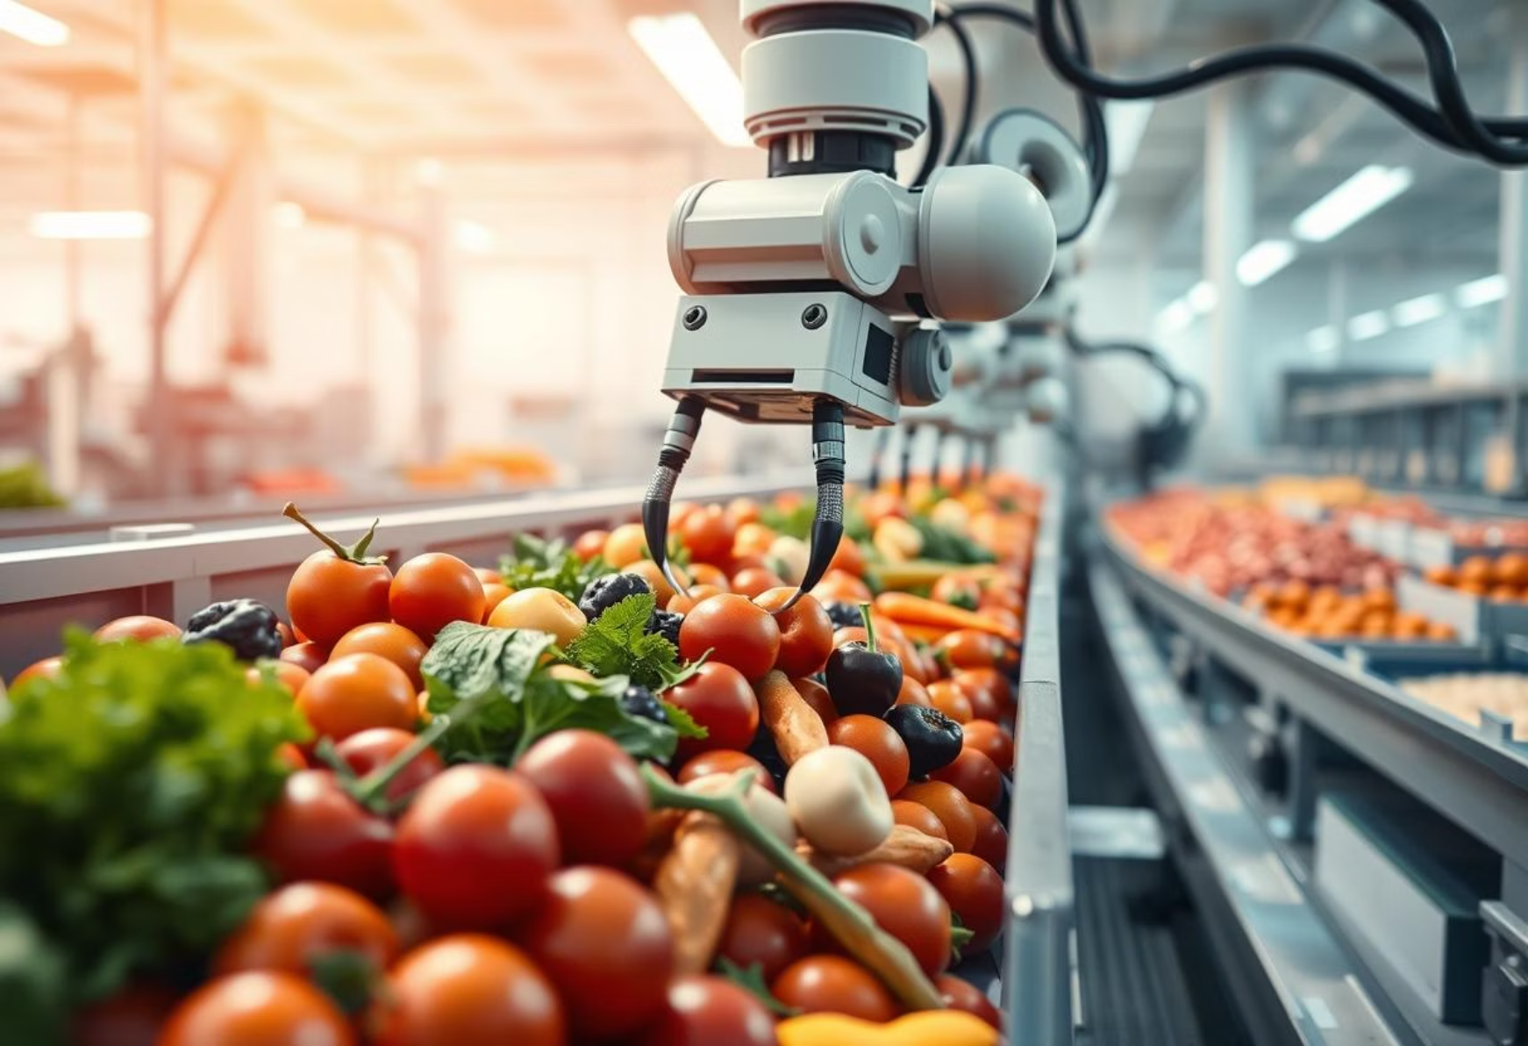

Advantages and Disadvantages of AI Sorting
Advantages:
Disadvantages:
Reduced Manual Effort
Dependency on Image Quality
Automating the sorting process significantly reduces the need for labor, freeing up human resources for other critical tasks.
The system's performance is highly reliant on the clarity and quality of the input images; poor images can lead to inaccuracies.
Fast and Reliable
Limited to Trained Categories
The system performs sorting at high speeds with consistent accuracy, outperforming manual methods in both pace and precision.
The model can only classify types of produce and conditions it has been specifically trained on, limiting its versatility without further training.
User-Friendly Interface
Requires Regular Updates
Designed for ease of use, the web application requires minimal training, making it accessible to a wide range of users.
To remain effective and accurate, the system necessitates periodic updates with new datasets to account for new produce types or variations in rot.
Reduced Time and Labor Costs
By automating, the project cuts down on operational time and associated labor expenses, increasing overall profitability.

Slide 8





Broad Applications of Smart Sorting Technology
Agriculture Industries
Food Processing Units
Grocery Stores & Supermarkets
From harvesting to packing, AI sorting can optimize initial quality checks, ensuring only healthy produce enters the supply chain.
Essential for maintaining high food safety standards and efficient production lines by quickly identifying and removing substandard items.
Enhances shelf life and customer satisfaction by ensuring only fresh, high-quality produce is displayed and sold.
Quality Control in Packaging
Restaurants & Catering Services
Automates final inspection before packaging, reducing human error and preventing defective products from reaching consumers.
Ensures that only the freshest ingredients are used, upholding culinary standards and reducing waste in food preparation.

Slide 9
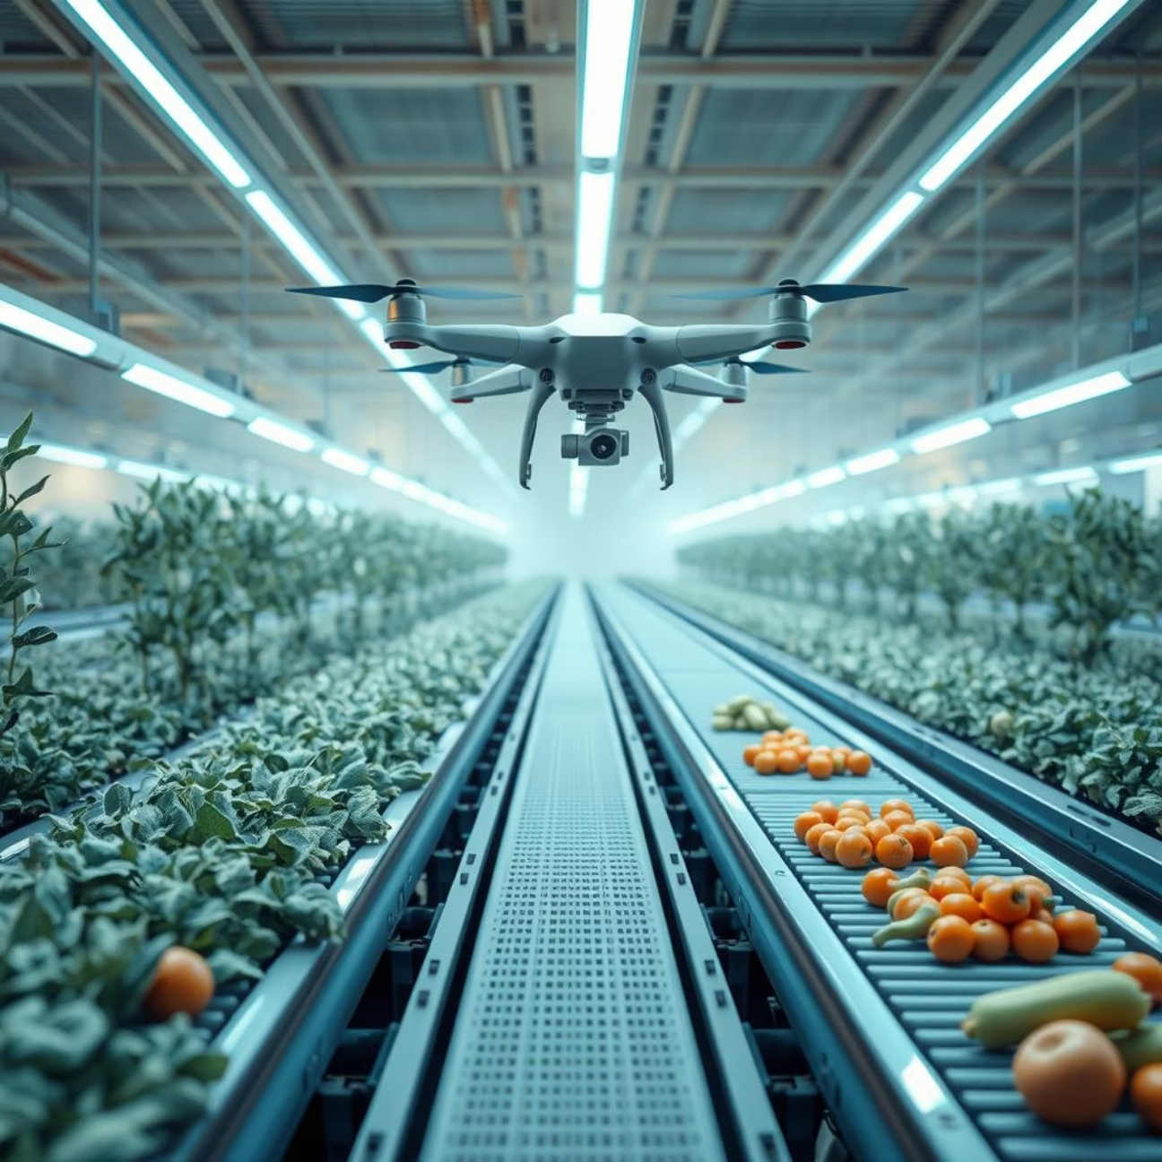




Future Scope and Enhancements
Expand Ripeness Classification
Develop the model to classify not just healthy or rotten, but also various levels of ripeness, offering more granular quality control.
Mobile Application Integration
Create a mobile app for on-the-go classification, allowing users to quickly assess produce quality using their smartphone cameras.
IoT Device Connectivity
Integrate with IoT-enabled conveyor belts for real-time, automated physical sorting, transforming sorting facilities.
Larger Dataset for Accuracy
Continuously expand the training dataset to further improve model accuracy and robustness across a wider variety of produce and conditions.

Slide 10

Conclusion: Impact and Potential of Smart Sorting
The smart sorting project, with its intuitive web interface and precise prediction model, offers a highly cost-effective and scalable solution for a multitude of sectors, including agricultural industries, food processing units, and retail. Its potential to profoundly impact quality control processes is immense.
Reduces Wastage and Labor Costs
Scalable Solution for Industries
Potential for Further Enhancements
The technology is designed to be easily adaptable and deployable across various scales of operations, from small farms to large processing plants.
By efficiently identifying and separating substandard produce, the system minimizes food waste and significantly lowers operational expenses.
The foundational model is robust, offering numerous avenues for future development, including ripeness classification and real-time integration with physical sorting systems.

